Slide 1

BIG DATA TECHNOLOGY FINAL PROJECT

Slide 2


BIG DATA TECHNOLOGY FINAL PROJECT
Tweet Analyzer

Slide 3
Submitted To: Prof. Mrudula Mukadam
Submitted By:
Saroj Kumar Dev
Nahom Debretsion

Slide 4

Technologies Used
CentOS Version 6.7
Hadoop Version 2.6.0
Java JDK & JRE Version 8
Eclipse Luna Service Release 2 (4.4.2)
Kafka Version 2.13-3.5.1
HBase Version 1.2.0
Hive Version 1.1.0
Spark Version 1.6.0
Tableau Version 2023.2.2

Slide 5

Project Overview
The goal of this project is to build a real-time Twitter analytics pipeline for gathering, processing, and
deriving insights from live tweet data. The system leverages various big data technologies:
- Streaming API: The Twitter Volume Sample Stream provides a feed of public tweets for collection.
- Ingestion: Kafka consumes the raw tweet stream into topics for buffering and downstream
consumption.
- Processing: Spark Streaming pulls tweet data from Kafka topics and transforms the tweets into a
structured format for analysis.
- Storage: HBase is used for low-latency storage and lookups of processed tweet data.
- Analysis: Spark SQL enables analytical queries on HBase tables to generate aggregated insights.
- Serving: Query outputs are stored back to HDFS for visualization. An external Hive table provides a SQL
interface.
- Visualization: Tableau connects to the Hive table on HDFS to build interactive dashboards and reports.

Slide 6
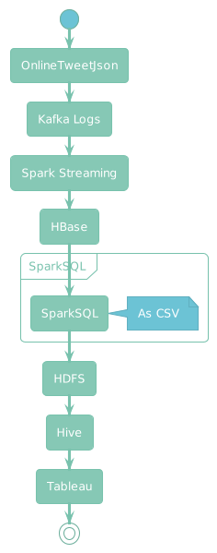
The Flow

Slide 7
In Depth Insight..
Twitter Kafka Producer
- Fetches sample-time tweets using the Twitter API
- Uses the Sample Twitter Volume Sample Stream API (https://raw.githubusercontent.com/SarozDev/BDTProjectData/main/BDTTwitter.json
- Streams the tweets into a Kafka topic in real-time as they are received from the API
- A Kafka producer is implemented to publish messages to the target topic
- This allows tweeting activity to be streamed into Kafka for downstream consumption and processing

Slide 8

In Depth Insight…
Spark Streaming Kafka Consumer
- Consumes the sample tweet stream from the Kafka topic.
- Passes the tweets to Spark for processing and analysis
- Spark aggregates and filters the tweets based on keywords defined in HBase tables
- Applies transformations to extract insights and derive aggregated metrics from the
tweet stream
- Filters the stream to relevant tweets containing keywords of interest
- Structures the tweets into a columnar format for analysis
- Stores the aggregated and filtered tweets back into HBase tables

Slide 9
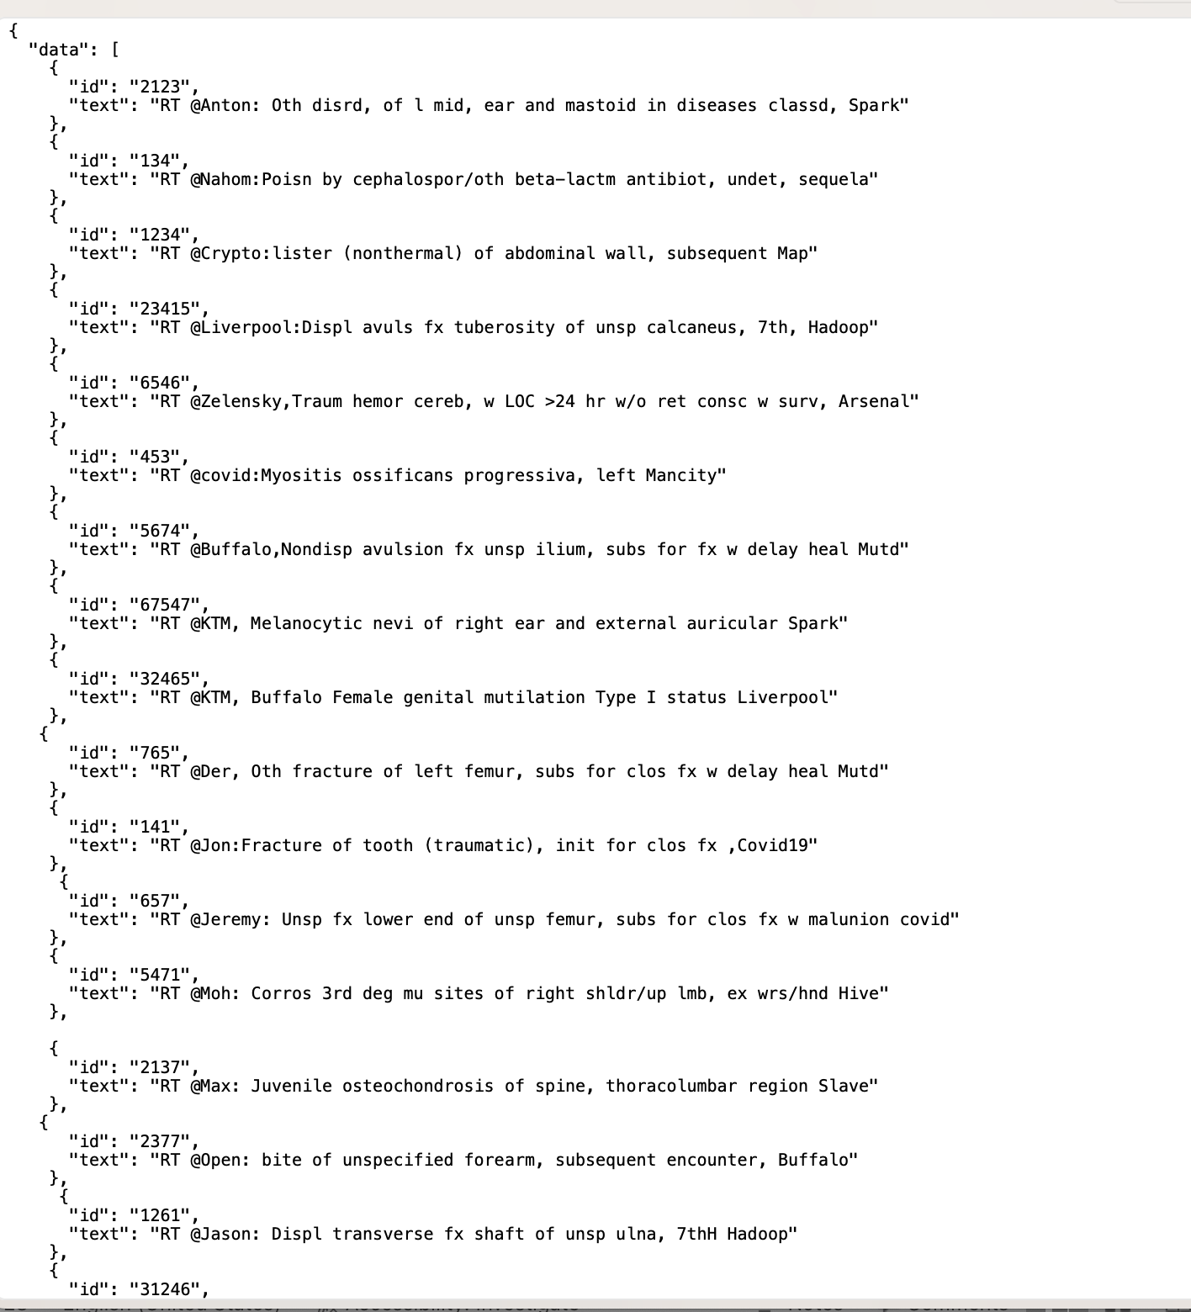
The Data..

Slide 10
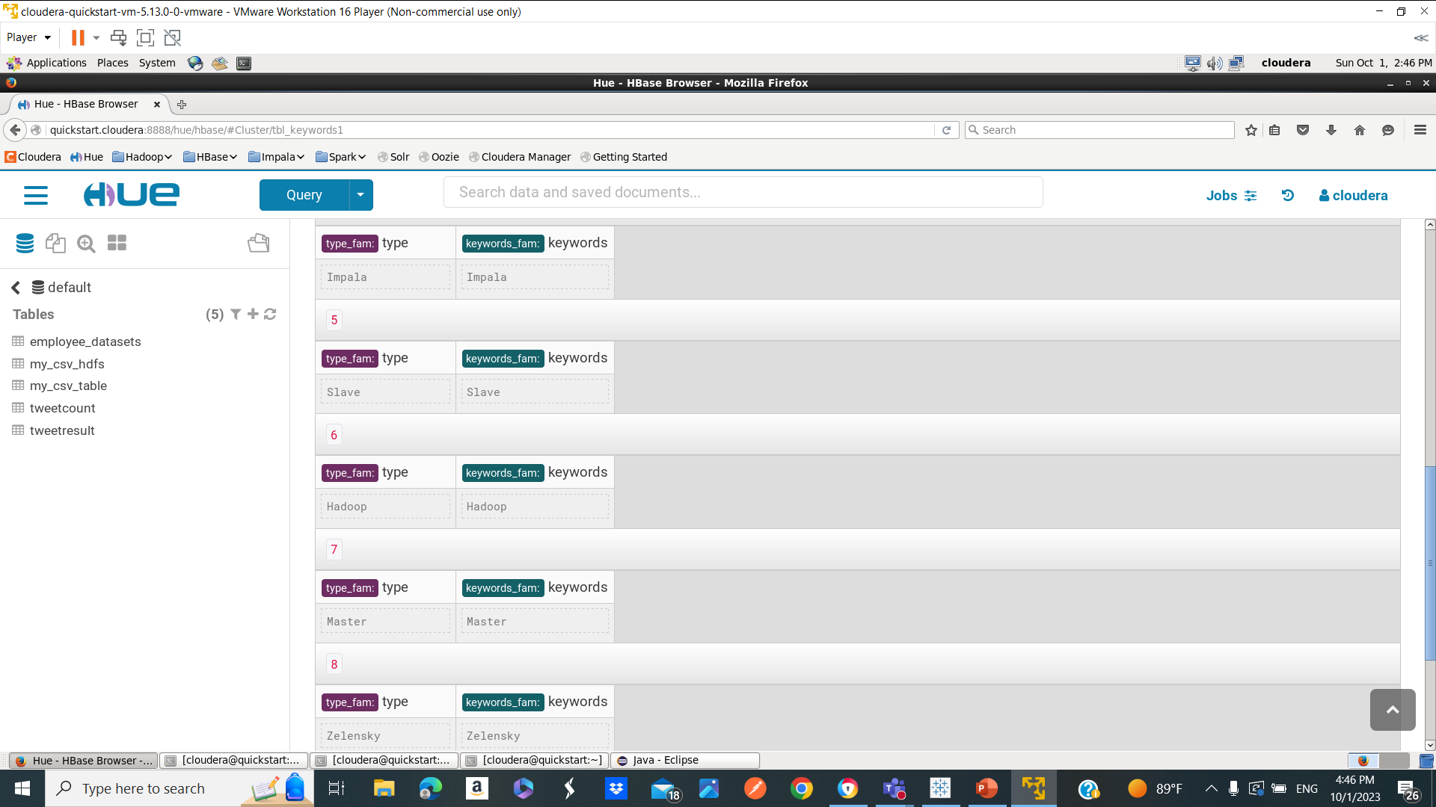
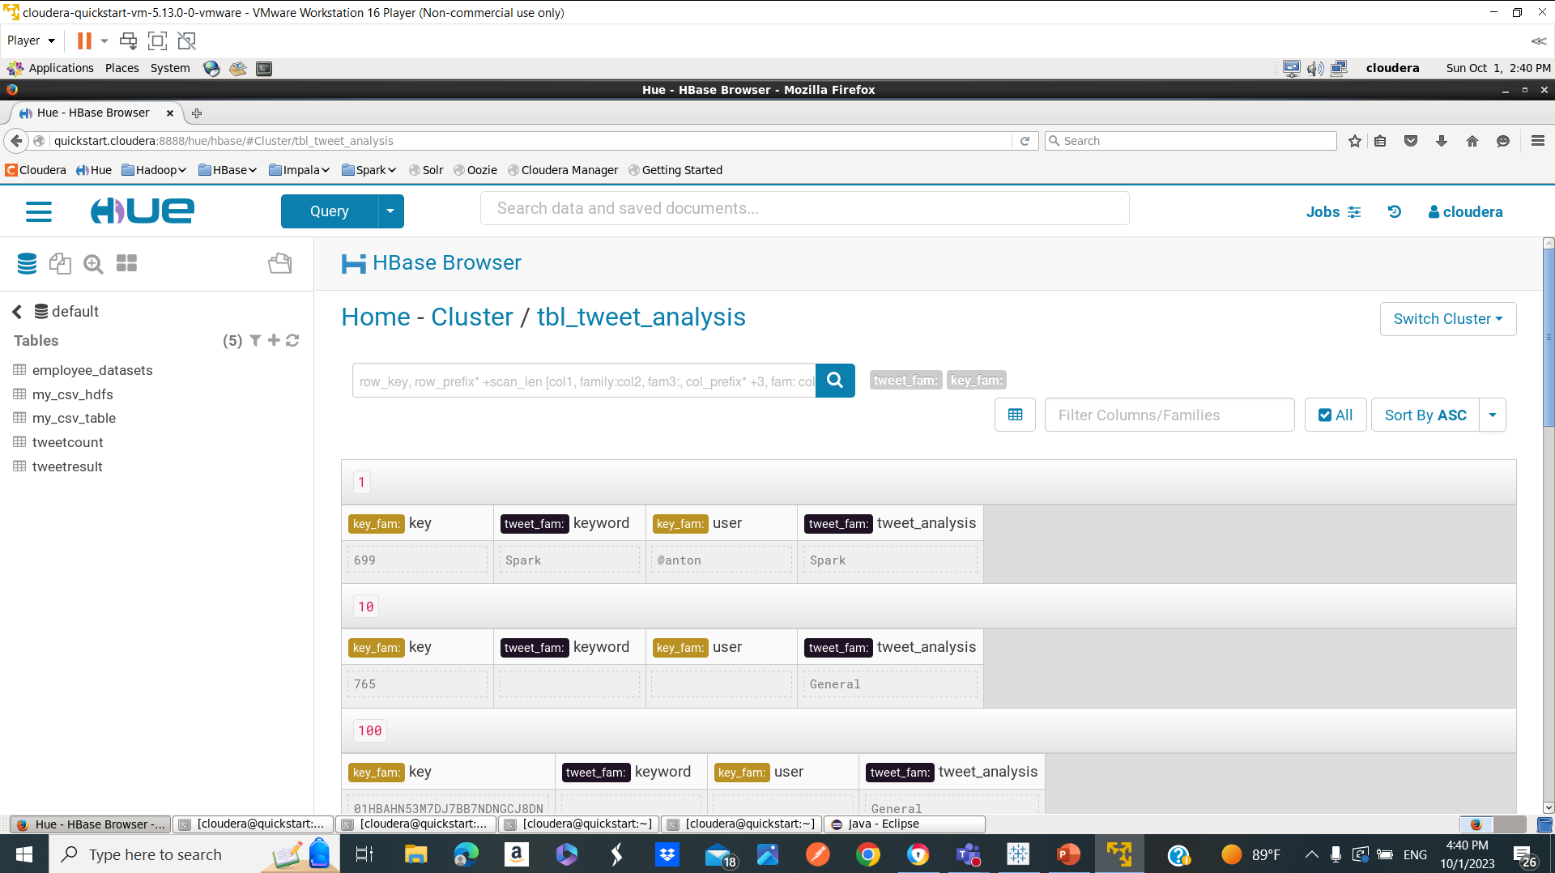
Spark Streaming from kafka to Hbase..

Slide 11
In Depth Insight..
Spark SQL
- Queries HBase to retrieve processed tweet data stored in tables
- Performs analytical Spark SQL queries on the tweet data, including:
- Grouping tweets by keywords
- Aggregating tweet counts by keyword, location, user, etc.
- Statistical analysis like mean tweets per time window
- Executes additional data transformations and aggregations to derive insights
- Structures the results into a clean CSV format
- Writes the CSV results set to HDFS
- Enables analysis on HDFS data via an external Hive table

Slide 12
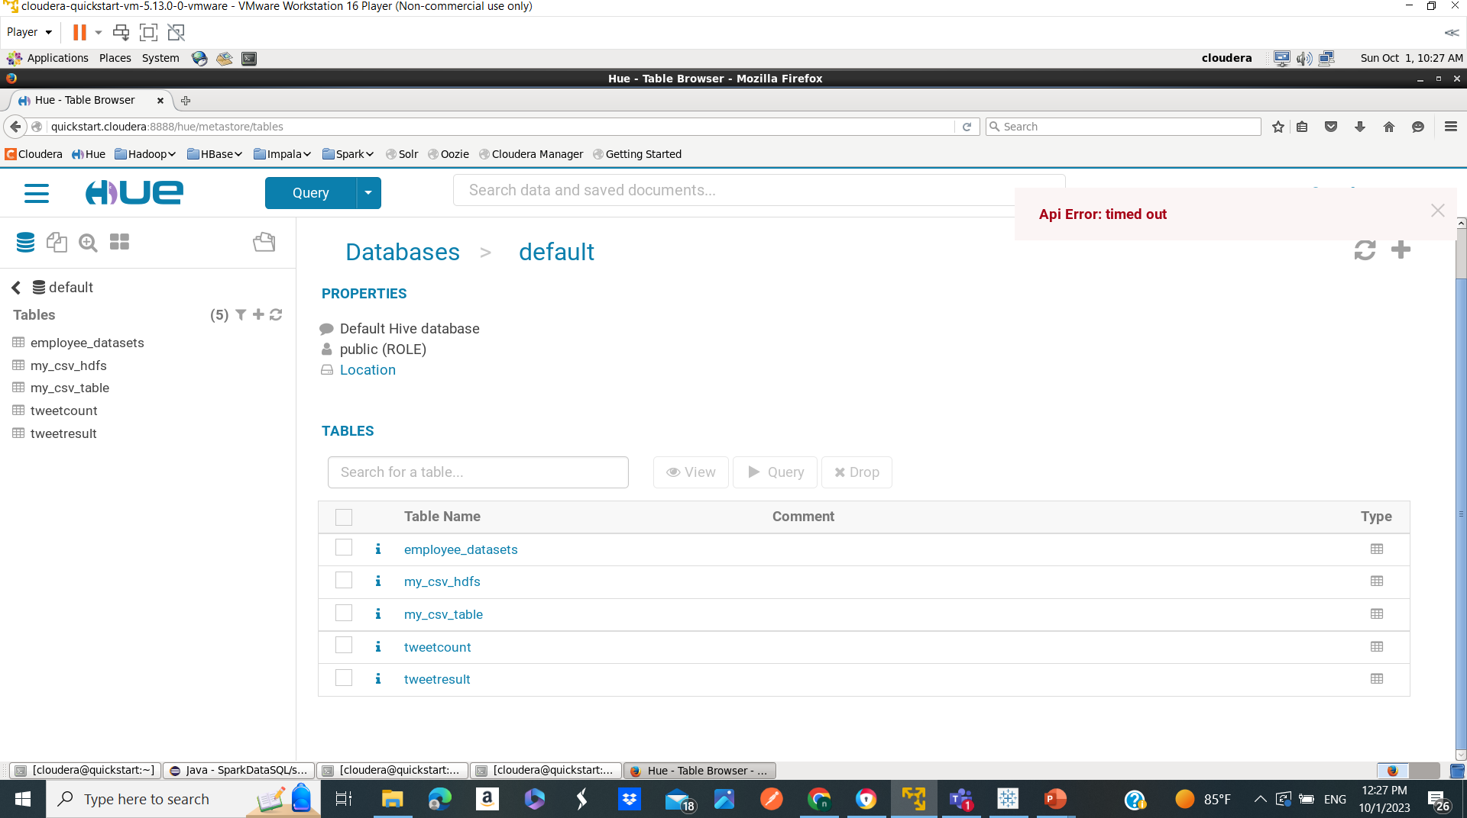
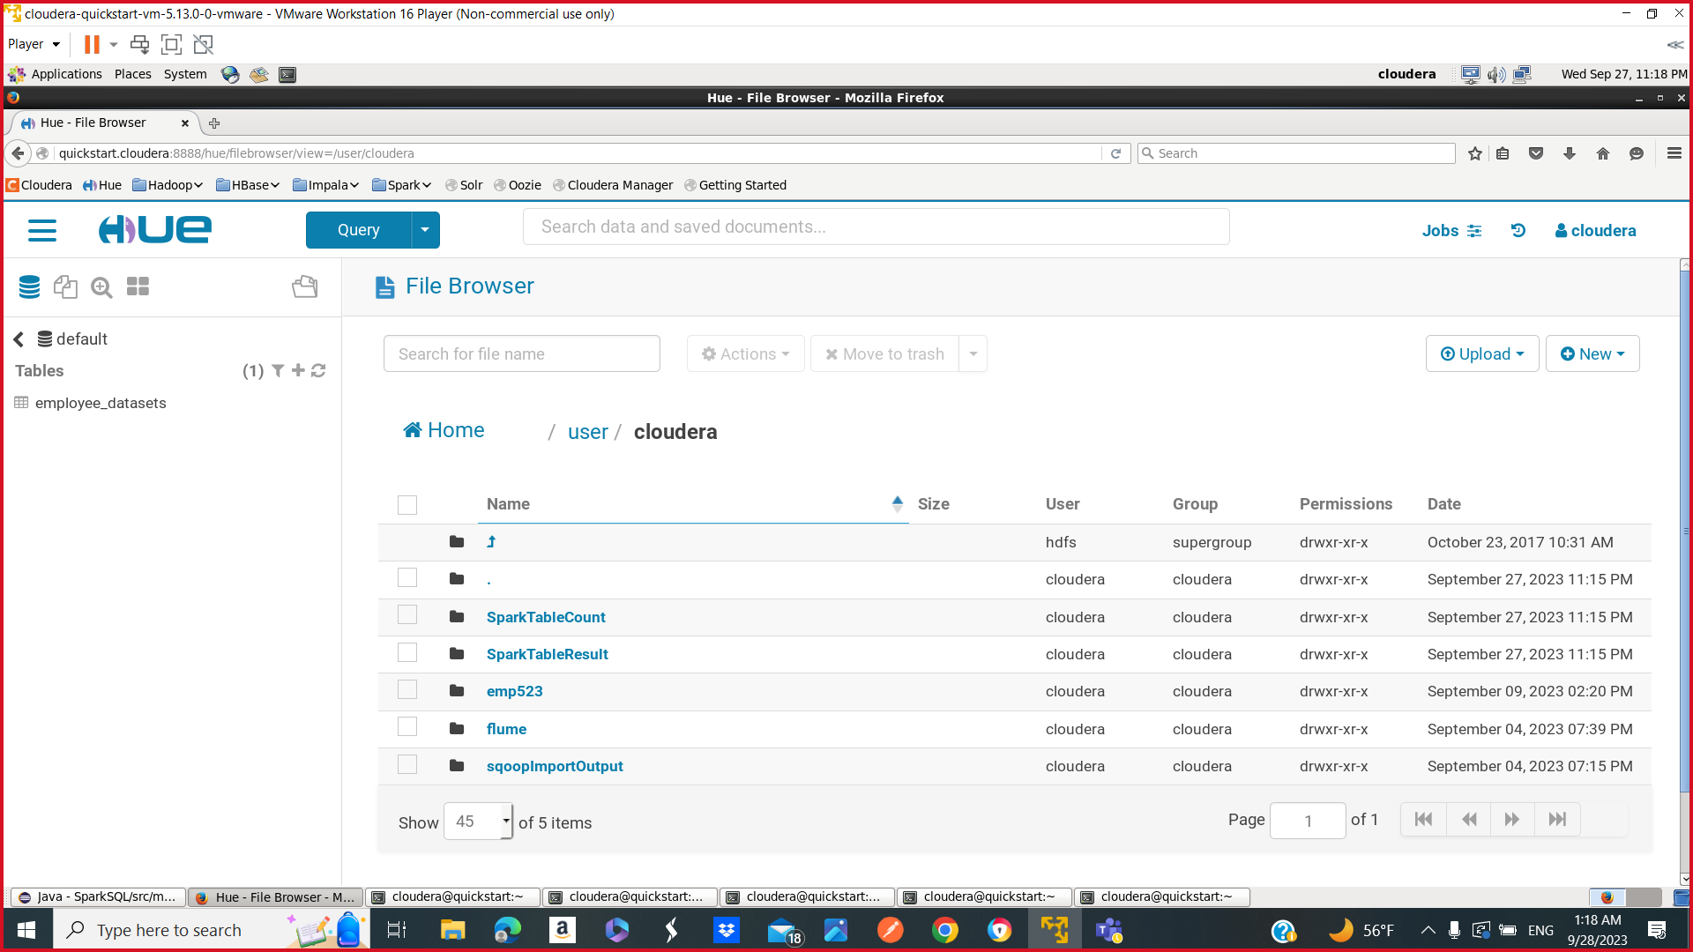
Spark SQL from HBase to HDFS..

Slide 13
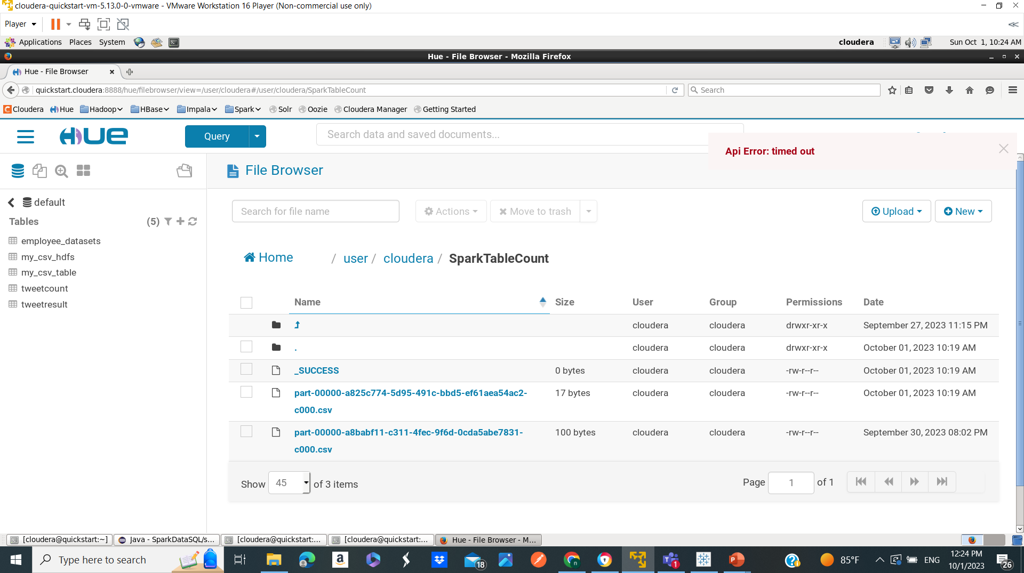
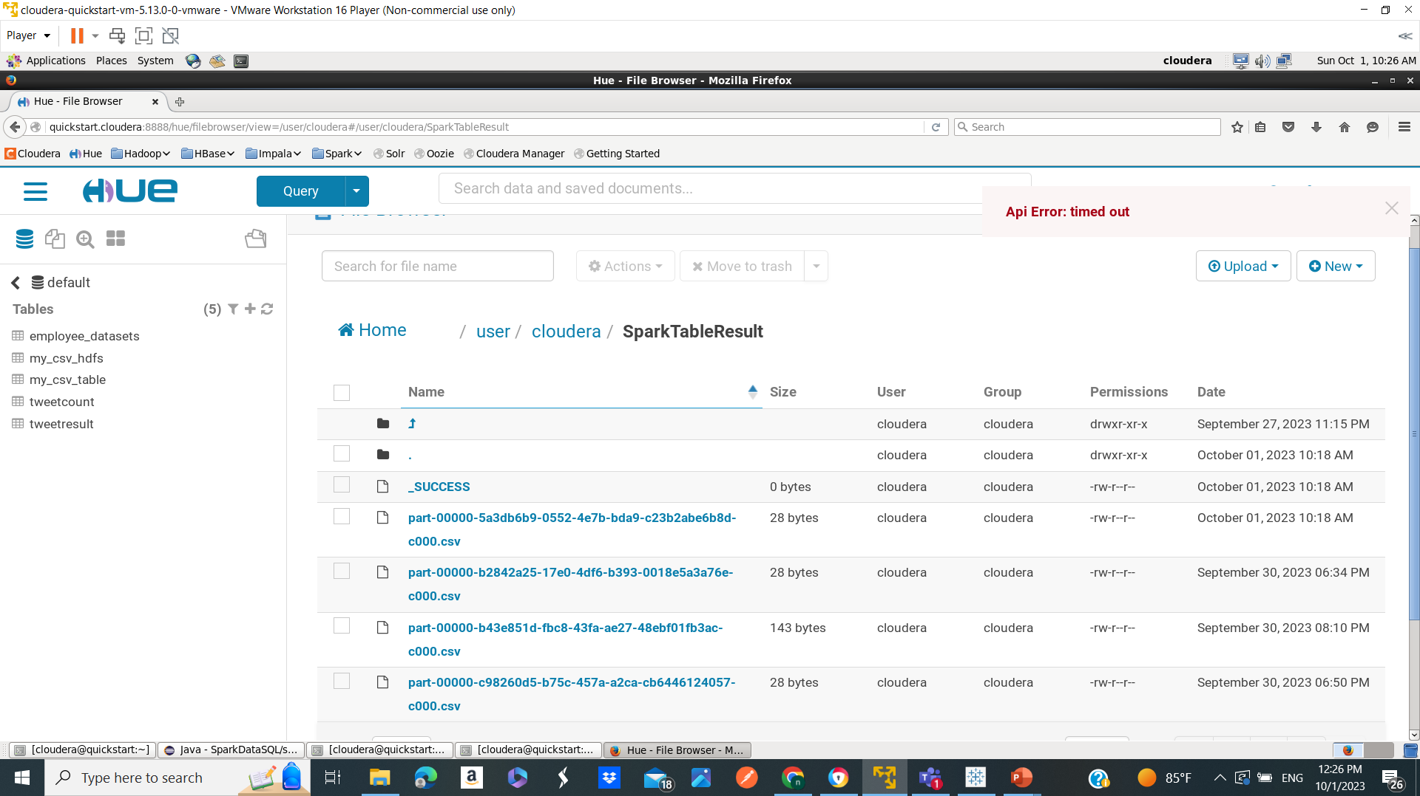
Hive CSV Files

Slide 14
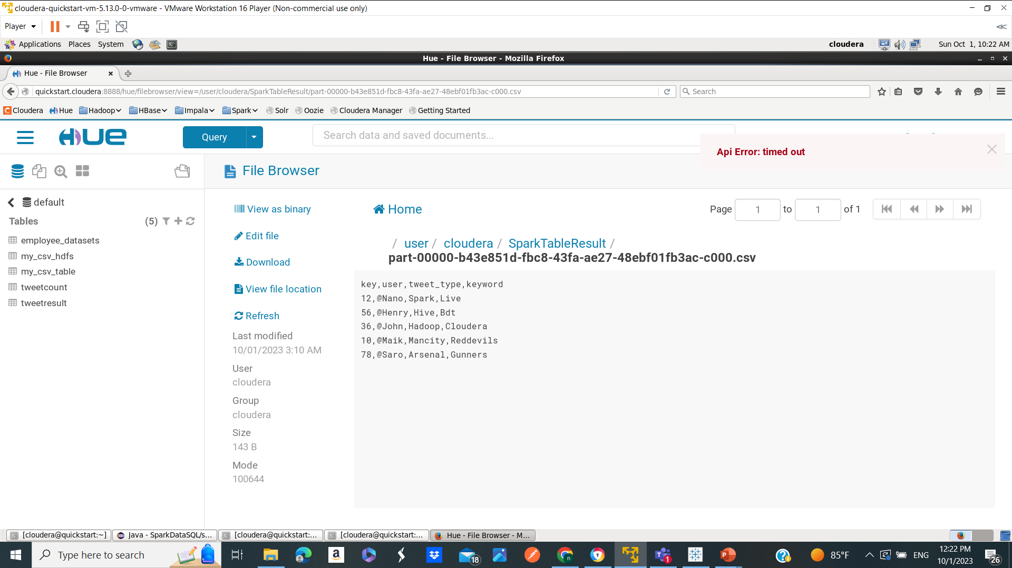
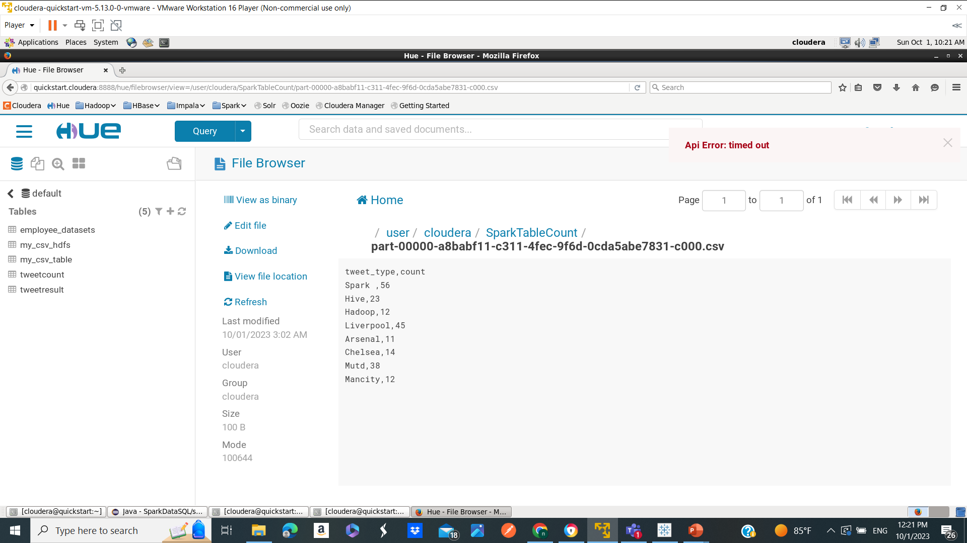
Hive Table Contents..

Slide 15
In Depth Insight..
Tableau
- Connects to the Hadoop cluster via the ODBC driver for Hive
- Queries the external Hive tables containing tweet analytics data stored on HDFS
- Loads the data into Tableau for interactive analysis and visualization
- Creates visualizations like pie charts, bar charts, and graphs to provide insights into the tweet data
- Enables ad-hoc data exploration on fields like keywords, locations, tweet frequencies, etc.
- Allows users to analyze and visualize results through dashboards, reports, and lenses

Slide 16
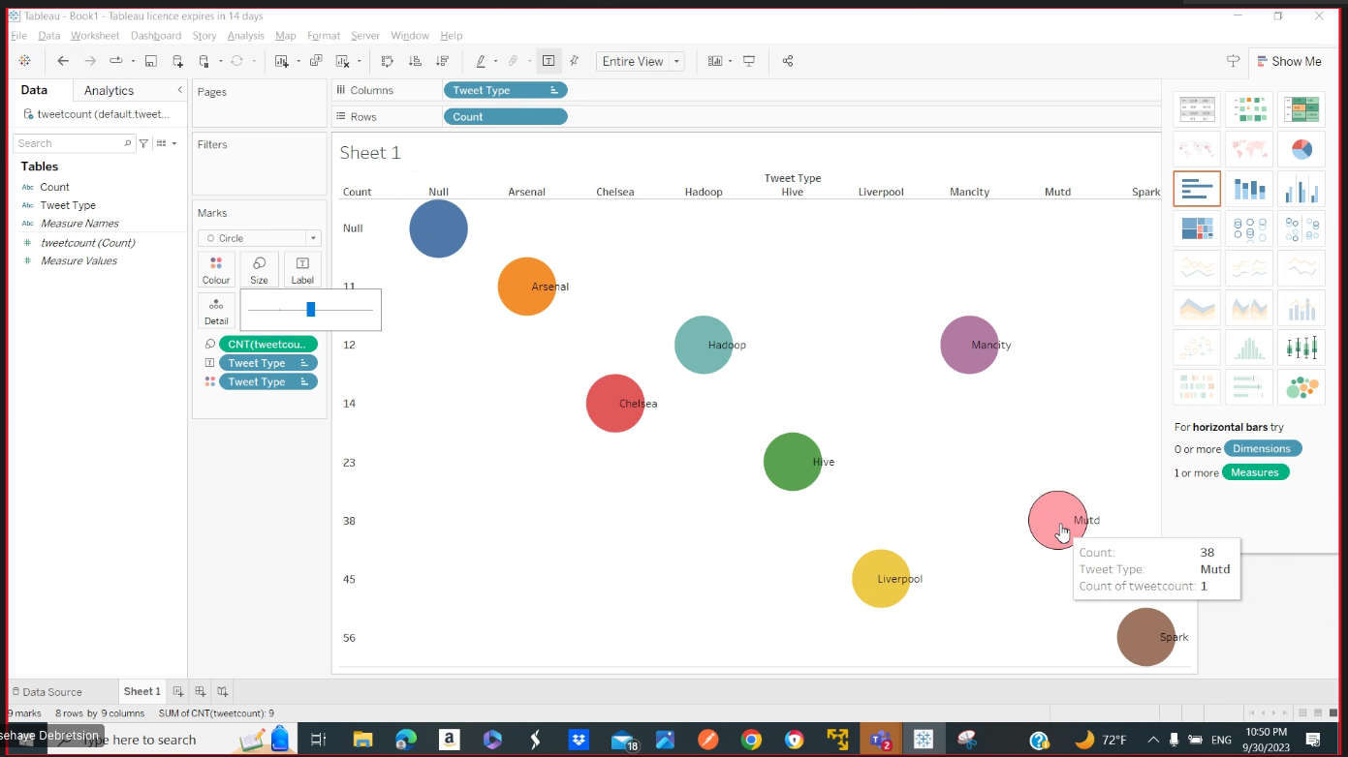
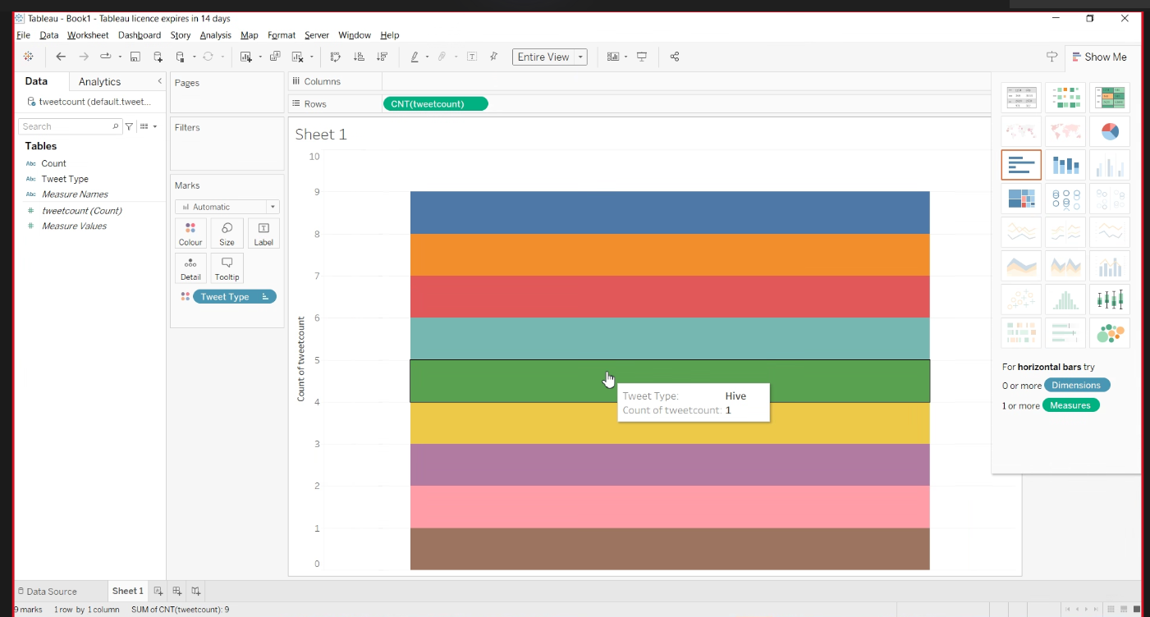
Tableau Visualization

Slide 17
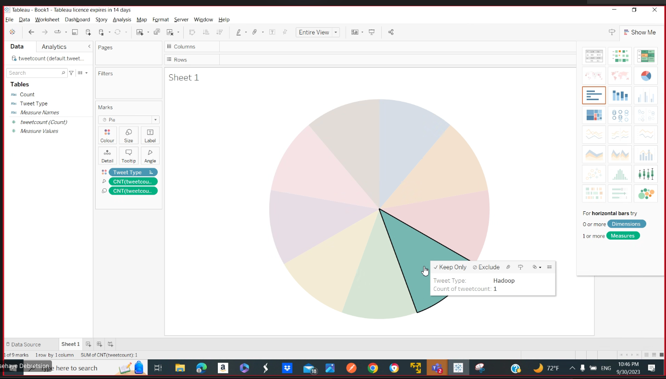
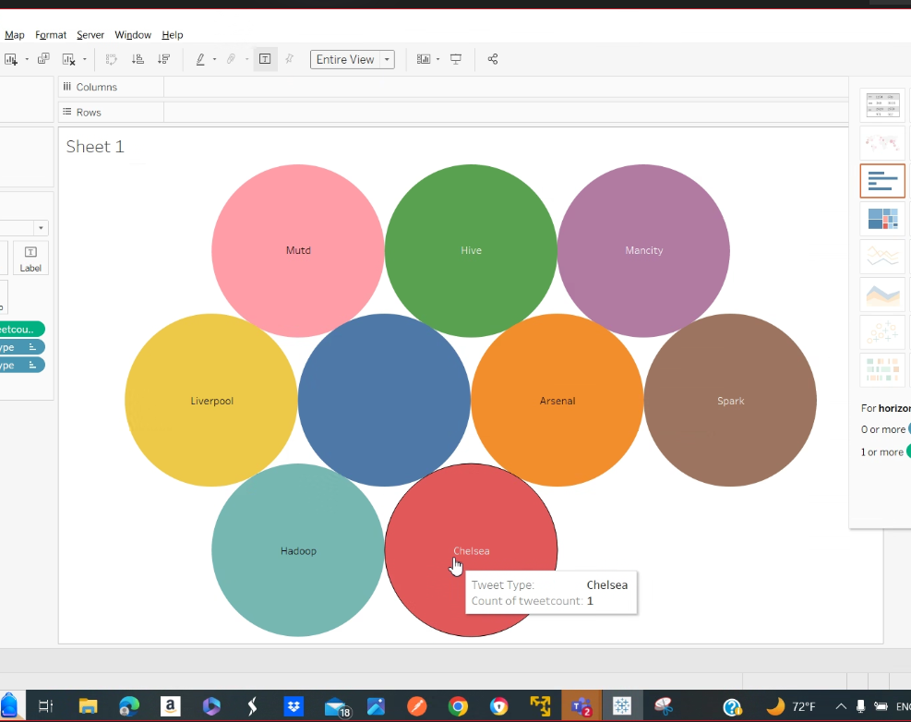
Tableau Visualization contd..

Slide 18
In Depth Analysis – Demo Steps..
Step 1:
Created a sample tweet json from Twitter Data.
Step 2:
Download kafka from https://kafka.apache.org/downloads
Extract to any location i.e. /home/cloudera/kafka
Run Zookeper using command ./bin/zookeeper-server-start.sh config/zookeeper.properties.
Run Kafka server using command ./bin/kafa-server-start.sh config/server.properties.
Create Topic using command ./bin/kafka-topics.sh –-create –topic tweet-topic – replication-factor 1 –partitions 1 –zookeeper localhost:2182

Slide 19
Demo Steps contd..
Step 3:
Run Hbase using command: sudo service hbase-master start
Run Hbase using command: sudo service hbase-regionserver start
Step 4:
Run the SparkStreamline application which starts the consumer and keeps it ready.
Run the kafkaProducer to pull the data which is then consumed by consumer.
Run the SparkSQLData application and store the tweets in HDFS in the form of CSV files.

Slide 20
Demo Steps contd..
Step 4:
Create the External HIVE table by using the CSV files stored in HDFS.
Step 5:
Download the Hive ODBC driver.
Connect to Tableau with Cloudera Hadoop using ODBC Driver.
Step 6:
Fetch data from HIVE table and show it in the graph and other diagrams.

Slide 21

Wholeness and Consciousness of Project
We implemented a big data pipeline to ingest real-time tweets, analyze them, and visualize the results. The technologies used include:
- Kafka for streaming tweet ingestion
- Spark for processing and analyzing tweets
- Hive for structured storage and SQL queries
- Tableau for interactive visualization and dashboards
The pipeline enables ingesting live tweets, filtering and aggregating them in Spark, performing analytics with Spark SQL, and visualizing results in Tableau charts/graphs.
Science and Technology of Consciousness: Daily Transcendental Meditation practice allows one to experience deeper levels of the unified field of consciousness underlying all creation. The holistic benefits of TM become evident in improved quality of life and greater harmony between ourselves, others and nature. By transcending thought during TM, we tap into reservoirs of creativity, intelligence, and positivity deep within the self.

Slide 22

"Grateful for the transformative Big Data journey and eager to apply my newfound skills!"

